Slide 1
POLISH TRAVELERS
Anna Broda
Marta Knapik

Slide 2
JASIEK MELA

Slide 3
Jan Mela was born in 1988 in Gdańsk. He is a Polish explorer who, as a teenage double amputee, was the youngest person to reach the North Pole in 2004 and eight months later the South Pole. He created the Foundation „Outside the horizons”.

Slide 4
NORTH AND SOUTH POLE
FOUNDATION „OUTSIDE THE HORIZONS”
ACCIDENT

Slide 5
The story really began in 2002, when Janek -who comes from Malbork in Poland-was 13 years old. He was playing table tennis with some school friends when it suddenly started raining heavily. He sheltered from rain in an electrical transformer building in Malbork, where he was electrocuted by a 15,000 volt shock. The burns and tissue damage sustained meant surgeons had to amputate his leftcrus and right forearm.
ACCIDENT

Slide 6
Jasiek Mela Foundation Poza Horyzonty (“Beyond Horizons”) was founded in December 2008, the day before the birthday of the founder. From it’s inception, the foundation has been trying to provide a wide range of help to victims of accidents, who are waiting for artificial limbs and are in need of a psychological and/or legal support. The role of the Foundation is also to help disabled persons to integrate with the rest of society.
FOUNDATION „OUTSIDE THE HORIZONS”

Slide 7
As a member of a four-man expedition led by veteran Polish polar explorer Marek Kamiński called "Together to the Pole", Mela reached the North Pole
on April 24, 2004 at the age of 15. After nine days
of polar acclimatisation in Spitsbergen, Norway,
the team began their 70 km trek on April 4,
and received no outside assistance, relying solely
on the supplies and gear they could pull on sleds. Eight months later, Mela and Kamiński reached the South Pole in Antarctica on December 31,
2004 – a day after Mela's 16th birthday.
NORTH AND SOUTH POLE

Slide 8
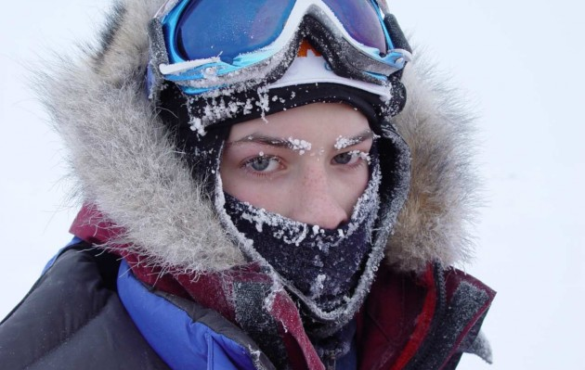
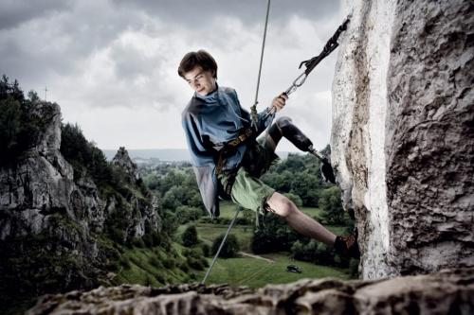
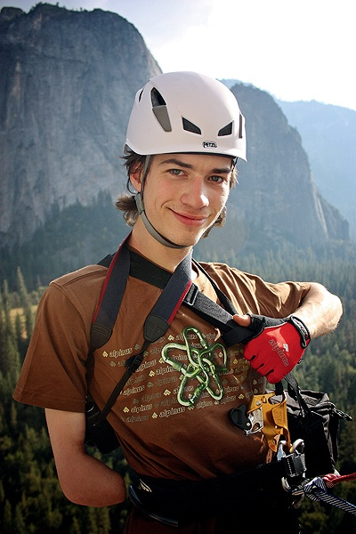
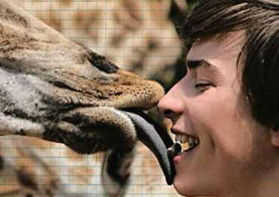
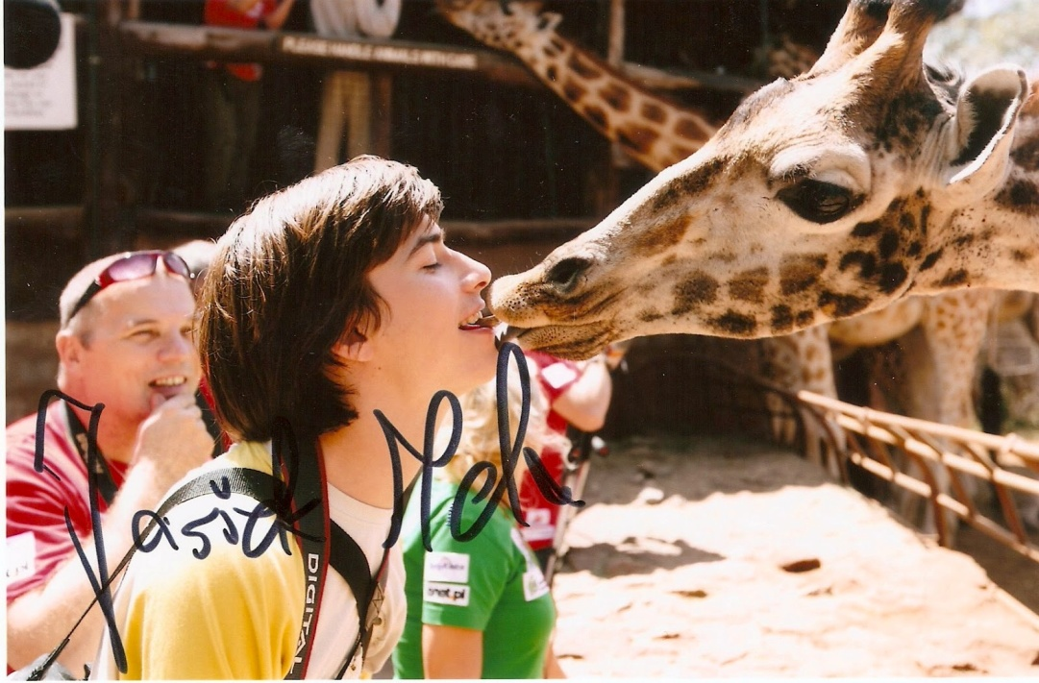

Slide 9
WOJCIECH CEJROWSKI

Slide 10
Wojciech Cejrowski was born in 1964 in Elbląg.
He is a Polish traveller, television and radio journalist, writer, Catholic publicist, satirist, photographer.
For over 20 years, almost every year he is looking
for wild tribes in South America.

Slide 11
BAREFOOT THROUGH THE WORLD
ROYAL GEOGRAPHICAL SOCIETY
CONTROVERSIAL

Slide 12
"Wojciech Cejrowski - Barefoot Around the World", produced for TVP 2 Entertainment Section is the winner of New York Festivals 2008 (Travel & Tourism). A series/recording of Wojciech Cejrowski's travels provides not only standard information on places worth seeing but more importantly it explains symbols, ideas, values and beliefs characteristic for any given country. Wojciech Cejrowski tries to familiarize the viewers with culture of various regions by participating in everyday tasks and rituals, discussions with locals and tasting traditional food. It allows him for an anthropological analysis of the observed phenomena.
BAREFOOT THROUGH THE WORLD
ROYAL GEOGRAPHICAL SOCIETY
Wojciech Cejrowski is the Fellow of the Royal Geographical Society. He was the third Pole in the history of the Society to become
a Fellow

Slide 13
In 2000, he broke the security line in the Warsaw Gallery. He wanted to cover the figure of Jan Paweł II by sheet. Figure, which had meteorite
on the head. It was a protest against the saint exhibit.
In 1999 Wojciech Cejrowski was convicted from the court and he got a punishment - 3000 zlotys because of the words, which he told direct to the President of Poland - Aleksander Kwasniewski. The court concluded that the words were insulting against the head of country.
CONTROVERSIAL

Slide 14
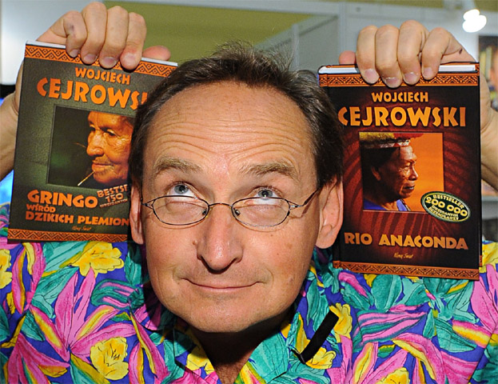
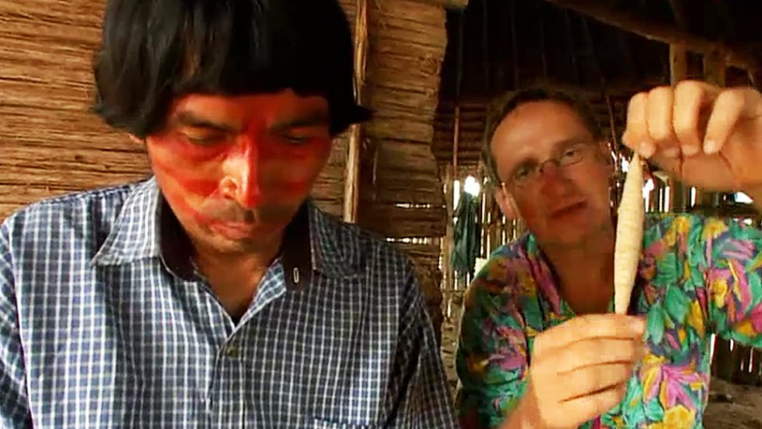
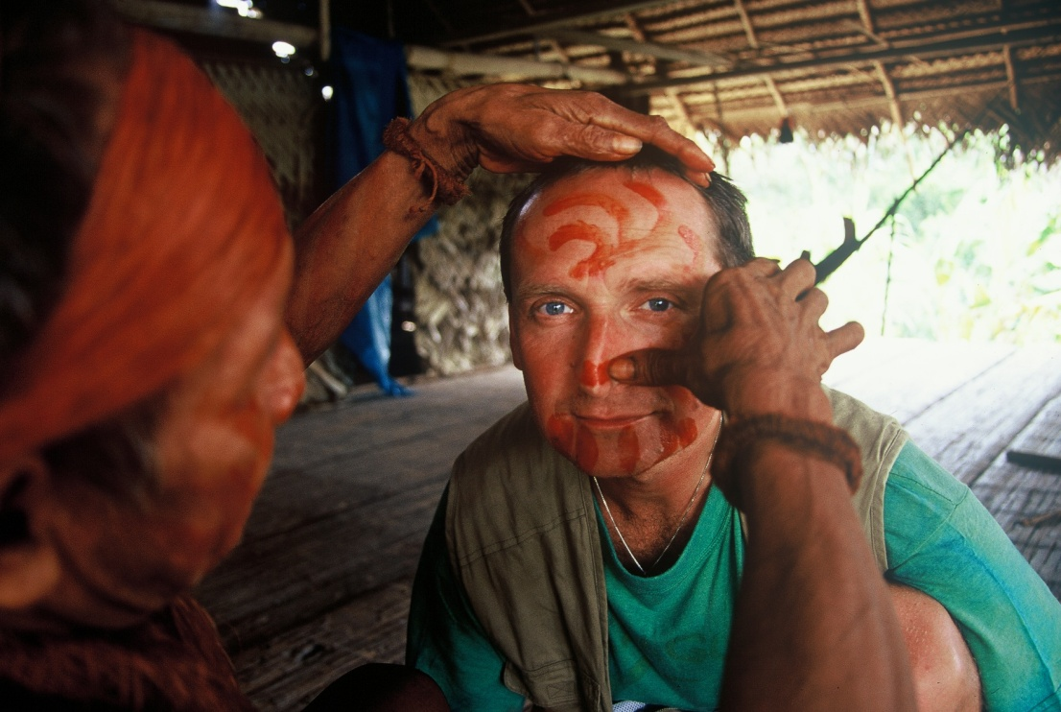
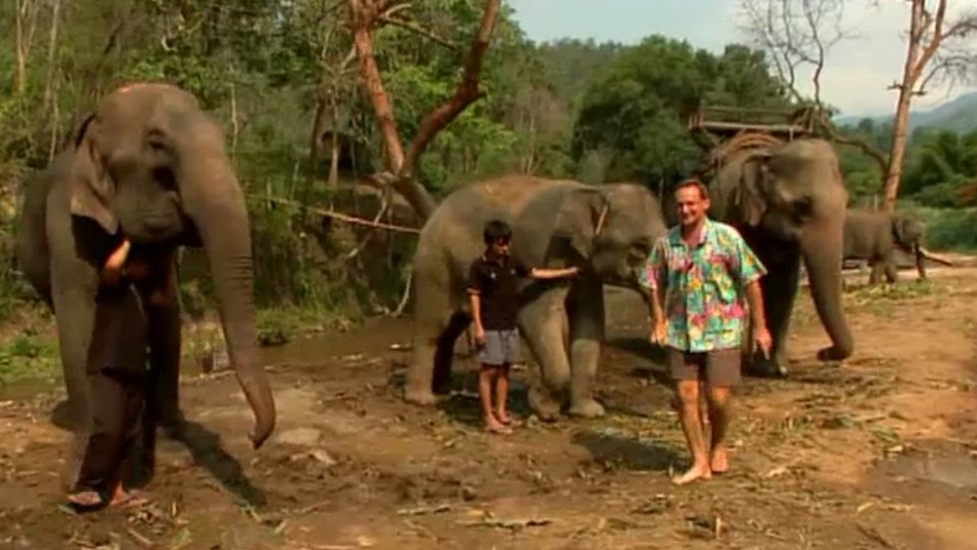
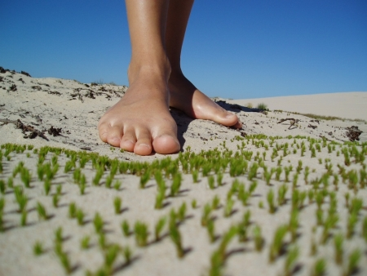

Slide 15
MARTYNA WOJCIECHOWSKA

Slide 16
Marta Eliza Wojciechowska was born in 1974 in Warsaw. She is Polish television presenter, journalist, traveller, writer, rally driver and licensed diver. 22 January 2010 she stood on last top gaining the Seven Summits. She is the third Polish woman who climbed the highest mountains on all seven continents and the second Pole who climbed in a more difficult version of Reinhold Messner.

Slide 17
WOMEN ON THE EDGE OF THE WORLD
DAKAR RALLY
NATIONAL GEOGRAPHIC

Slide 18
„Two seasons of Misja Martyna – a travel & adventure TV series were my most awaited
and dreamed of program. Together with my production crew I traveled the world to the most untypical and exotic places. By trying to blend
in with the lives of local people, a will to face their culture and history, I gave viewers knowledge about certain countries. I was happy every day on the road. “A woman at the end
of the world” was another of my television dreams. This time only women are at the centre of attention.”
WOMEN ON THE EDGE OF THE WORLD
DAKAR RALLY
Wojciechowska is a rally car driver. She has been involved in the Paris-Dakar Rally.
NATIONAL GEOGRAPHIC
She is the editor of the Polish edition of National Geographic Magazine and
National Geographic Traveler.

Slide 19
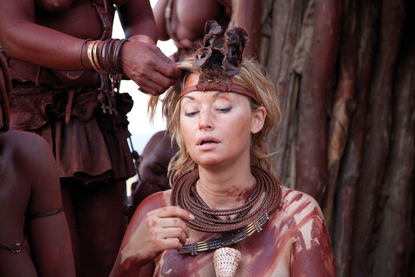
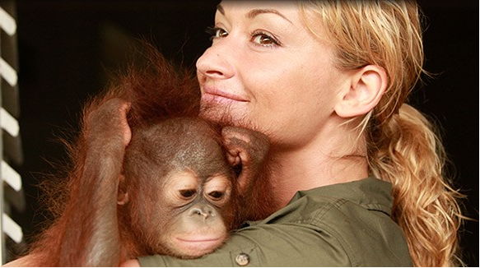
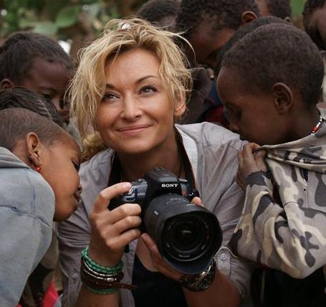
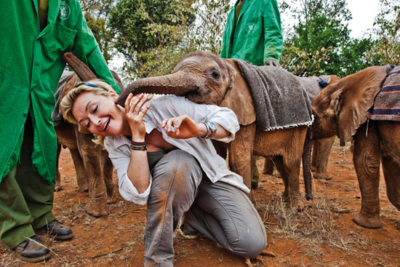
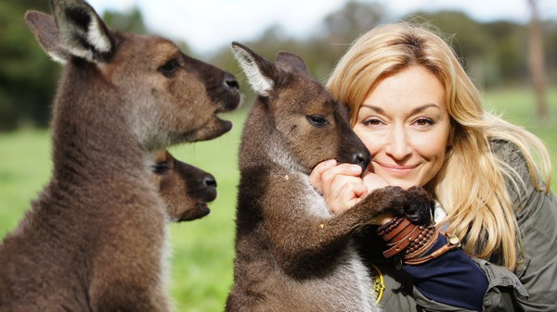

Slide 20
MAREK KAMIŃSKI

Slide 21
Marek Kamiński is Polish Polar explorer, author, photographer, entrepreneur. He was born in 1964
in Gdańsk. He studied philosophy and physics
at Warsaw University. He is founder
of the Marek Kamiński Fundation.
Major expeditions: “TransGreenland Expedition”, Antarctica, Kilimanjaro, Kościuszko Mountain in Australia, Zanzibar.

Slide 22
THE MAREK KAMIŃSKI FOUNDATION
GUINNESS BOOK OF RECORDS
THROUGH THE WORLD WITH POLA
DA VINCI LEARNING

Slide 23
The Marek Kamiński Foundation was founded
in 1996. It is involved in creating and running educational programmes, fund-raising for prostheses for those in need, and integrated camps for
the disabled. Its statutory aims also include supporting exploration of the Polar regions and other places worldwide, promoting Polar studies
and ecology and supporting young participants
in expeditions.
The Marek Kamiński Foundation
Guinness Book of Records
“First on South Pole and North Pole in the same year” - Record entered the Guinness Book in 1995.

Slide 24
„Throught the world with Pola” is Marek Kamiński Foundation’s new project.
Marek Kamiński, his wife Katarzyna and their one-and-half year old daughter – Pola are showing fascinating world of travel with
a baby.
Through the world with Pola
Marek Kamiński is ambassador
of The Da Vinci Learnig which is educational channel for kids.
Da Vinci Learning

Slide 25
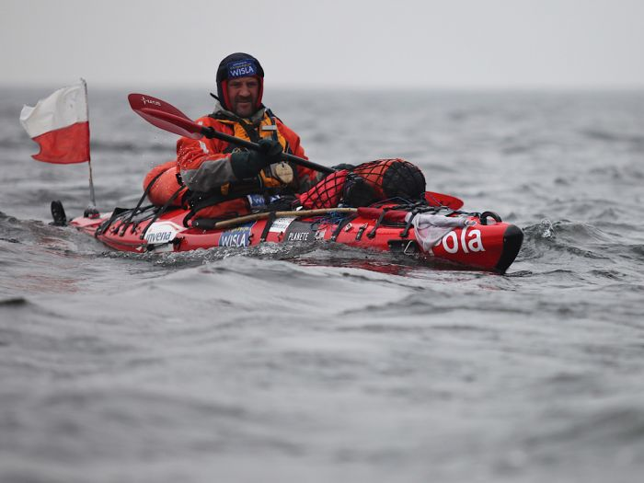
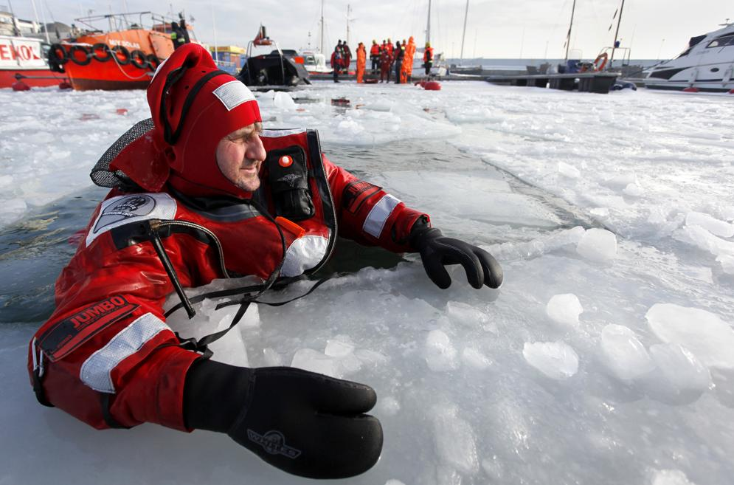
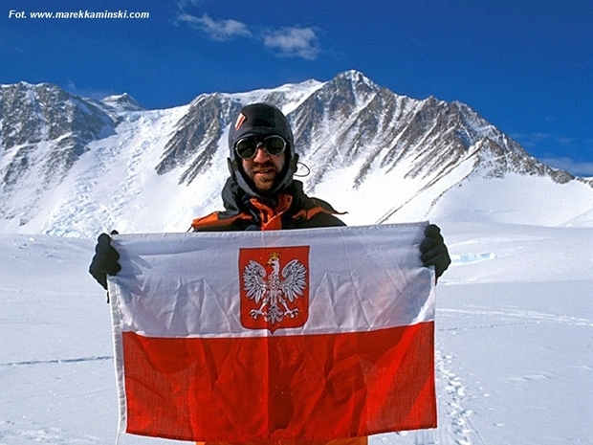
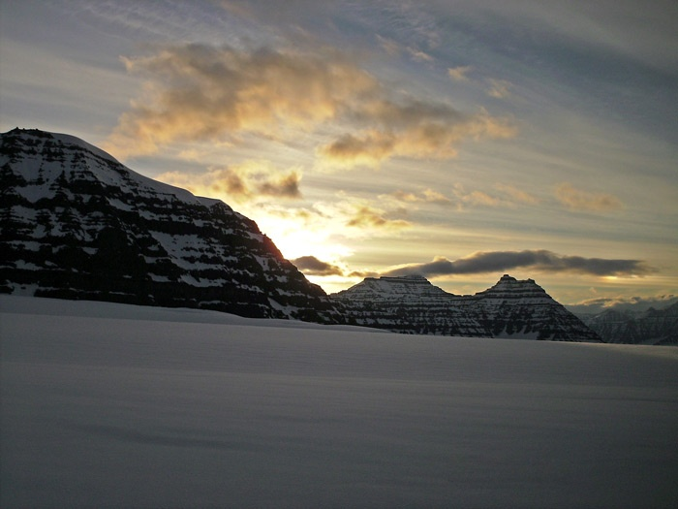

Slide 26
ANTONY HALIK

Slide 27
Antony Halik ( Mieczysław Antoni Sędzimir Halik)
was a Polish traveler and explorer. He was born in 1921 in Toruń, Poland. During World War II,
he was a fighter pilot in No. 201 Squadron of British RAF. After the war, he was working
as a correspondent for NBC for over thirty years.
For over twenty years, Halik and his wife hosted over
three hundred TV shows and series for Polish
Television. He also created over four hundred
documentary films, wrote thirteen books and many
press articles.

Slide 28
GREEN HELL
180 THOUSAND KILOMETERS OF ADVENTURE
MUSEUM OF TRAVELLERS TONIE’GO HALIKA

Slide 29
In the years 1955-1956 he second time returned
with his wife to the Mato Grosse (Green Hell), state
of Amazon. They separated from a hunting expedition and went down to the river Araguaia along the bank
for looking for the river Rio das Mortes
(River of Death). Instead of it, they found out, however, the mountain chain - Serra do Roncador, in which
Tony Halik discovered system of tunnels and caves (one of them called the Cave of the White Eagle).
returning home, wrote two books about it: 200 dias
de Mato Grosso (200 days in Mato Grosso) and Con Cámara y rifle a Través del Mato Grosso (with camera and rifle through Mato Grosso).
GREEN HELL
MUSEUM OF TRAVELLERS TONIE’GO HALIKA
In 2003 was founded
the Travelers’ museum of Tony Halik. Most of the exhibits are presents from Elizabeth Dzikowska who till today continues adding new ones.

Slide 30
The most famous journey he had with his wife,
with Pierrette Jeep from America to Alaska.
It began in 1957 and lasted for 1536 days – had travelled the 182 624 km (four times more than
the length of Earth's equator), spent more than
$ 80,000. Then they visited 21 countries, crossed the 140 rivers and swamps, built 14 bridges
and changed eight sets of tires. The highest place, reached by them it was 5200 meters above the sea. They were traveling under the temperatures
from -50 to +60 ° C. During the trip they used
the tent, which were damaged 684 times.
They spent 1253 nights in the tent. At the end
of the trip (in 1962), on the Arctic Circle, they drove two flags into the ground: Polish and Argentinian.
180 THOUSAND KILOMETERS OF ADVENTURE

Slide 31
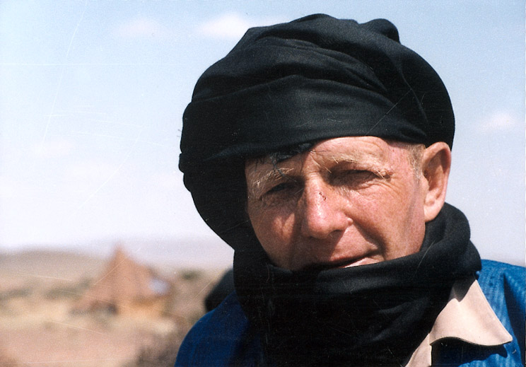
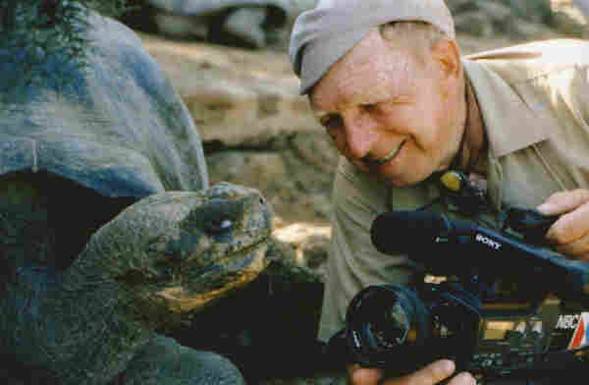
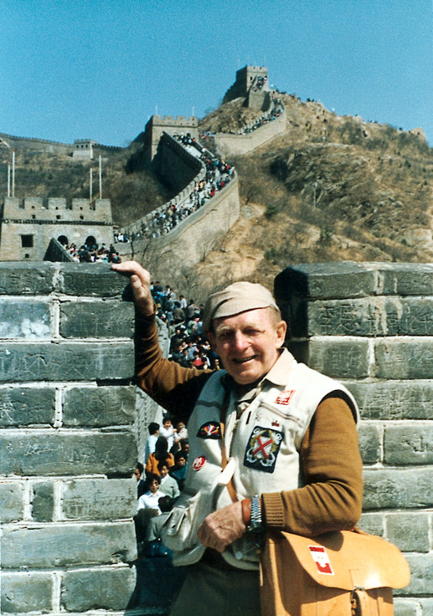
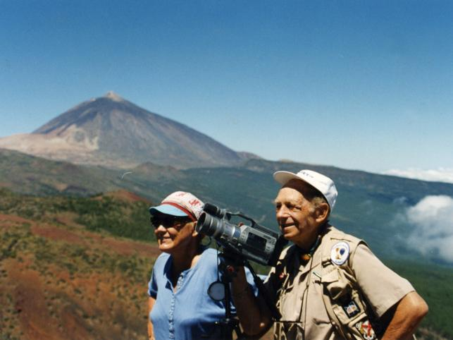
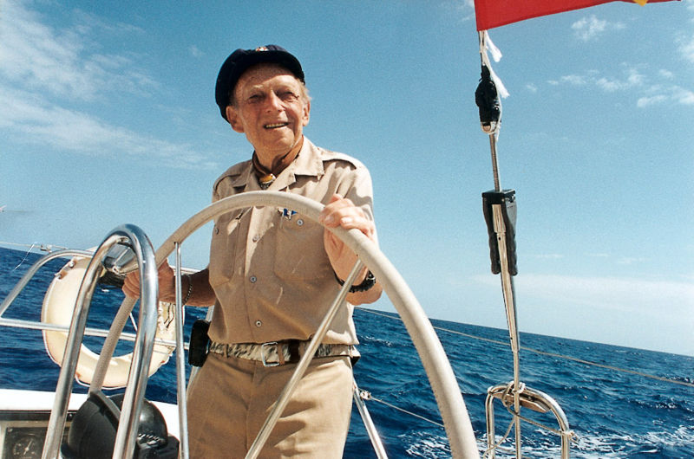

Slide 32
JERZY KUKUCZKA

Slide 33
Jerzy Kukuczka was born in 1948 in Katowice.
He was a Polish alpine and high-altitude climber.
On 18 September 1987, he became the second man, after Reinhold Messner, to climb all fourteen eight-thousanders in the world.

Slide 34
EIGHT-THOUSANDER
WINTER OLYMPICS
LHOTSE

Slide 35
Kukuczka is widely considered among the climbing community to be one of the best high-altitude climbers in history. He ascended all fourteen mountains in just under eight years, a shorter time than any climber before (Reinhold Messner included, whom it took 16 years) or since. In the process, Kukuczka established ten new routes
and climbed four summits in winter. He was one
of an elite group of Polish Himalayan mountaineers who specialized in winter ascents.
EIGHT-THOUSANDER
In 1988 during the Olympic Games in Calgary,
with Reinhold Messner, was awarded by silver Olympic Medal. Reinhold Messner refused to get
the medal, and explained that alpinism is art,
not competition. Kukuczka accepted the medal, because for his alpinism is spirit of sport.
WINTER OLYMPICS

Slide 36
Kukuczka died attempting to climb the unclimbed South Face of Lhotse in Nepal on 24 October 1989. Leading a pitch at an altitude of about
8,200 meters on a 6 mm secondhand rope he had picked up in a market in Kathmandu (according
to Ryszard Pawłowski, Kukuczka's climbing partner on the tragic day, the main single rope used by the team was too jammed to be used
and the climbers decided to use transport rope instead), the cord either was cut or snapped
from a fall, plunging Kukuczka to his death.
LHOTSE

Slide 37
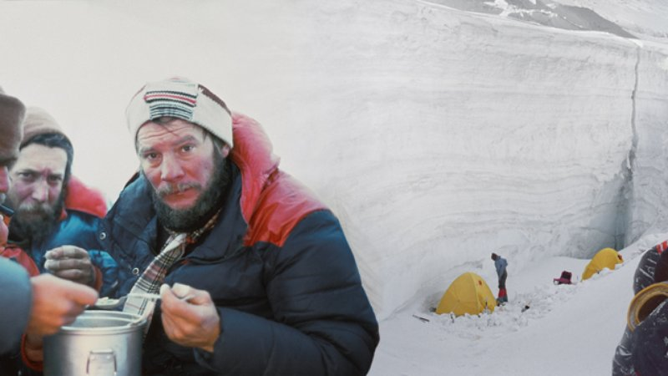
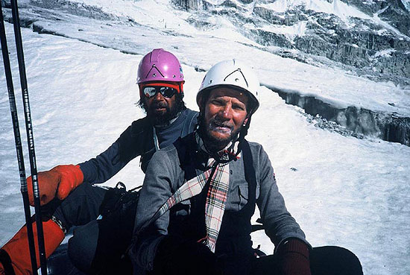
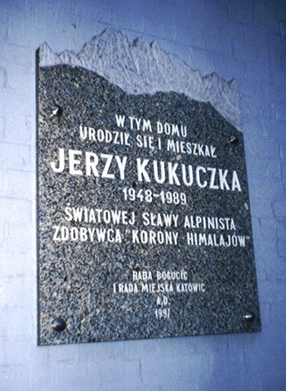
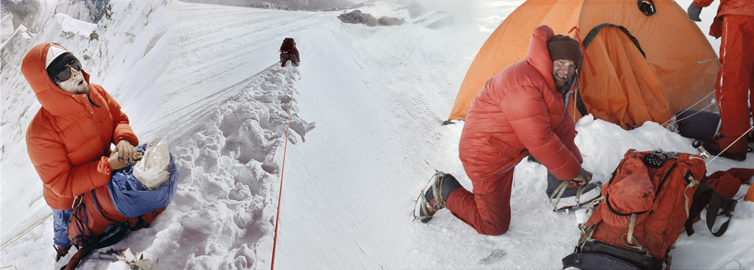

Slide 38
WANDA RUTKIEWICZ

Slide 39
Wanda Rutkiewicz was a Polish mountain climber .
She was born in 1943 in Plunge, Lithuania. Began climbing in the rocks near the Janowice
Wielkie (Mount Falcon (Polish: Góry Sokole).
Rutkiewicz's goal was to become the first woman
to summit all fourteen of the eight-thousanders.
During her climbing life she successfully summitted
the following mountains: Mount Everest, Nanga Parbat, K2, Shisha Pangma, Gasherbrum II,
Gasherbrum I, Cho Oyu, Annapurna I, Kangchenjunga.

Slide 40
ELECTRONIC
MOUNT EVEREST
K2
CAR RACES
KANCZENDZONGA

Slide 41
Was trained as an electronics engineer.
Studied at the Technical University of Wroclaw, with a degree in electronics engineer working
at the Institute of Power Systems Automation. Later moved to Warsaw, she started to work
at the Institute of Mathematical Machines.
ELECTRONIC
K2
In 1986 she became the first woman to successfully climb and descend K2, which she did without supplemental oxygen, as part of a small expedition led by Lilliane and Maurice Barrard.
MOUNT EVEREST
On 16 October 1978, she became the third woman, the first Pole and the first European woman to reach the summit of Mount Everest.

Slide 42
After the two attempts to get K2 Wanda decided to take a break from the mountains. When she had free time, was doing another extreme sport - Car rajdom. In the car she was as self-confident as on the top of the mountain. She liked fast driving.
CAR RACES
It was while climbing Kangchenjunga that
49 year-old Rutkiewicz was last seen alive
by Mexican climber Carlos Carsolio. She was sheltering at high altitude on the north-west face, during her attempted ascent of what would have been her ninth eight-thousander. At that moment Rutkiewicz was physically weakened and not able to make a rational decision that could have saved her life.
KANCZENDZONGA

Slide 43
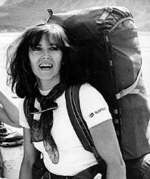
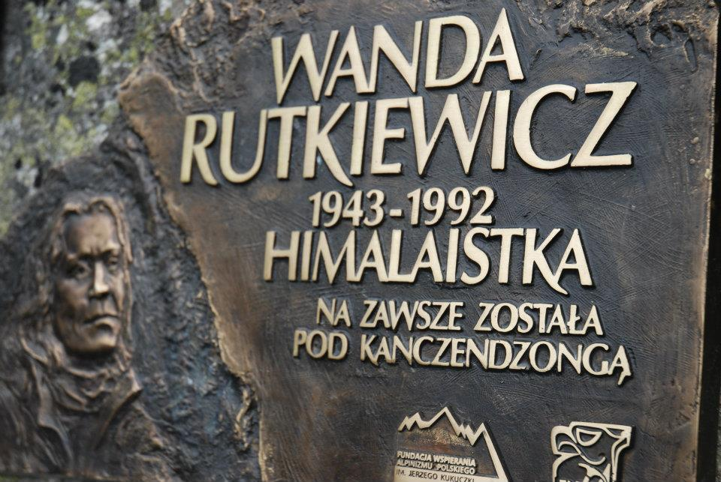
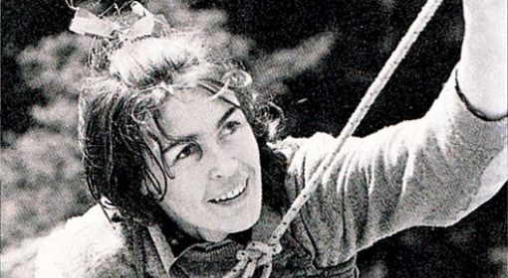
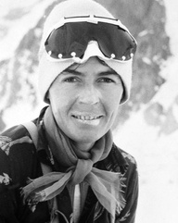
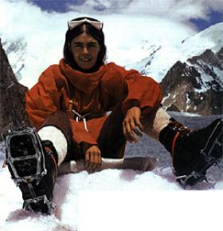

Slide 44
Bibliography:
http://www.national-geographic.pl/
http://www.marekkaminski.com/
http://www.kaminski.pl/
http://www.cejrowski.com/
http://www.martynawojciechowska.pl/
http://pl.wikipedia.org/wiki/Strona_g%C5%82%C3%B3wna

Slide 45
THANK YOU FOR YOUR ATTENTION

